Slide 1

Your
Service
Coordinator
And You
Understanding Services and Access
By Mario A. Lopez
www.pacifichousing.org

Slide 2


  WHAT IS A SERVICE COORDINATOR (SC)?
The American Association of Service Coordinators’ (AASC) manual and AASC Professional Service Coordination Certificate (PSC) Program identify the major roles and functions of the service coordinator (SC) as a facilitator, advisor, educator, advocate, and community services referral agent for a community of residents.
Chapter 8 HUD Handbook - It is the Department's finding that service coordinators are necessary to coordinate supportive services for the elderly, disabled, and families residing in eligible housing projects. Service coordinators are needed to link the elderly or disabled residents residing in the projects to the supportive services necessary for them to remain independent and in their own homes.
www.pacifichousing.org

Slide 3
  WHAT are the benefits of an SC?
For seniors and disabled adults, service coordinators assist in accessing needed supportive services to allow them to:
Maintain their independence and remain in their homes
Avoid premature admission to more costly institutionalized care
For low-income families, service coordinators provide assistance and access to community-based supports, skills training and resources. They also work with the adults in the family to develop a plan of action to assist them in:
Achieving greater economic security by linking them with programs to improve their literacy, job skills, education, and money management training
Improving the educational performance of low-income children by linking them to after-school programs, nutritional assistance, and other programs to aid them in moving out of poverty
For owners and operators of apartment communities, service coordinators can:
Reduce apartment turnover and damage by intervening and assisting with resolution of lease violations
Facilitate a stronger sense of community at affordable apartment complexes thereby decreasing crime and increasing the safety at and marketability of these facilities
American Association of Service Coordinators (AASC)
www.pacifichousing.org

Slide 4

  8.4 - The major functions of the SC:
Provides general case management (including intake) and referral services to a residents needing such assistance
Establishes linkages with all agencies and service providers in the community; shops around to determine/develop the best "deals“ in service pricing to assure individualized, flexible and creative services for the involved residents).
Sets up a directory of providers for use by both project staff and residents.
Refers and links the residents of the project to service providers in the general community; these are, for example, case management, personal assistance, homemaker, meals-on-wheels, transportation, counseling, occasional visiting nurse, preventive health screening/wellness and legal advocacy
www.pacifichousing.org

Slide 5

  8.4 - The major functions of the SC:
Educates residents on service availability, application procedures, client rights, etc., providing advocacy as appropriate.
May develop case plans in coordination with assessment services in the community or with a PAC.
Monitors the ongoing provision of services from community agencies and keeps the case management and provider agency current with the progress of the individual.
Manages the provision of supportive services where appropriate.
May set up volunteer support programs with service organizations in the community.
www.pacifichousing.org

Slide 6

  8.4 - The major functions of the SC:
May provide training to project residents in the obligations of tenancy or coordinate such training.
May educate other staff on the management team on issues related to aging in place and service coordination, to help them to better work with and assist the residents.
May serve part-time as an OLSC (see paragraph 9.5 (g)).
www.pacifichousing.org

Slide 7

  8.4 - The major functions of the SC:
THE SERVICE COORDINATOR SHOULD NOT BE ASSIGNED RESPONSIBILITY AS THE PROJECT'S RECREATIONAL OR ACTIVITIES DIRECTOR, NOR PROVIDE SUPPORT SERVICES DIRECTLY (EXCEPT IN EMERGENCY SITUATIONS). THE SERVICE COORDINATOR, ALSO, CANNOT ASSIST WITH OTHER ADMINISTRATIVE WORK NORMALLY ASSOCIATED WITH THE PROJECT(S) OPERATING BUDGET.
www.pacifichousing.org

Slide 8




  How We Can Help…
Service Coordination is designed to help individuals strive for and achieve the highest quality of life.
Our Service Coordination uses a person-centered approach that is focused on assisting each person to achieve their unique goals and desires throughout life as independent as possible.
You and your service coordinator will become partners in advocating for, and gaining access to, necessary supports and services in the community.
www.pacifichousing.org

Slide 9

  How We Can Help…
Financial Assistance:
Reading and understanding bills
Calling companies regarding billing errors
Enrolling in benefit programs (i.e.: heating bill discounts)
Working with banks to provide checkbook balancing assistance
Negotiating quantity discounts at local businesses
Providing assistance with accessing entitlement programs
Medical Assistance:
Understanding and/or acquiring prescription drug benefit plans
Arrange for home health aide services
Coordinate wellness clinics
www.pacifichousing.org

Slide 10

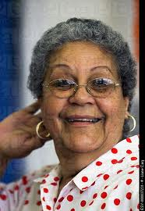
  How We Can Help…
Read and understand Medicare/Medicaid entitlements, appropriate policies and issues
Arrange physician appointments and transportation
Arrange for services with hospital discharge planner
Arrange for home medical equipment
Assist in setting up emergency medical information forms
Educational and Emotional Support:
Plan monthly presentations on topics such as living wills, telemarketing fraud, wellness and areas of resident interests
Coordinate nutritional programs
Partner with libraries to have resources delivered on-site
Assist in developing a residents’ association
www.pacifichousing.org

Slide 11
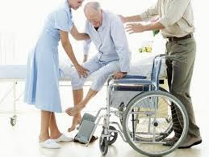
  How We Can Help…
Set up senior companion “buddy” programs
Connect with grief and loss counselors
Provide mediation assistance
Homemaker Assistance:
Assist in finding and arranging homemaker services
Arrange for grocery shopping services
Arrange for Meals-on-Wheels
Arrange for transportation for shopping and other needs
Legal Issues:
Assist in completing forms or obtaining necessary information regarding living wills or advance directives
Assist in reviewing social security earnings statements
Assist in reviewing death of a survivor’s benefits or making funeral arrangements for a loved one
www.pacifichousing.org

Slide 12

Case Management
The SC and the resident are introduced to each other for the first time. Residents usually provide basic demographic information. The SC listens, observes, notes and evaluates any particular need or present situation that could signify future service needs of the resident. For example, the SC may need to pay close attention to the resident’s capability to perform the activities of daily living (ADLs). The SC may conclude that a plan for a range of supportive services is needed to adequately assist the resident in performing their ADLs.
www.pacifichousing.org

Slide 13
Case Management
A service management plan may be developed when a resident brings a presenting need, problem, or situation and requests service from the coordinator. A service management plan may also be needed when the resident is referred by the property manager or other appropriate referral source. The plan should contain:
Referral source and reason for referral to the SC
Resident’s present need/situation or problem is stated. Assessment of presenting need, its level of complexity and the services needed or required to meet needs or resolve problems outlined.
The goals of the needed service and the specific referral process to the service provider(s) are stated.
The progress notes indicate follow up and monitoring of the services and their schedules of delivery noted in a timely manner.
Results of the service(s) provided to the residents are described. Feedback to management or other appropriate referral source is made as appropriate.
www.pacifichousing.org

Slide 14
Case Management
When needed, the case management process steps include the appropriate compliances and forms that insure confidentiality, release of necessary information, reports of abuse, exploitation and fraud, and other compliance areas that may be legally required by the state or as policies of the management company.
Summary
In sum, individual residents of a facility often require a specific plan of service to meet their needs. To accomplish this end, SCs use a general case management model that emphasizes the development of a service management plan in which intake, assessment, plan of referral and linking to a specific service or network of services are presented.
American Association of Service Coordinators (AASC)
www.pacifichousing.org

Slide 15
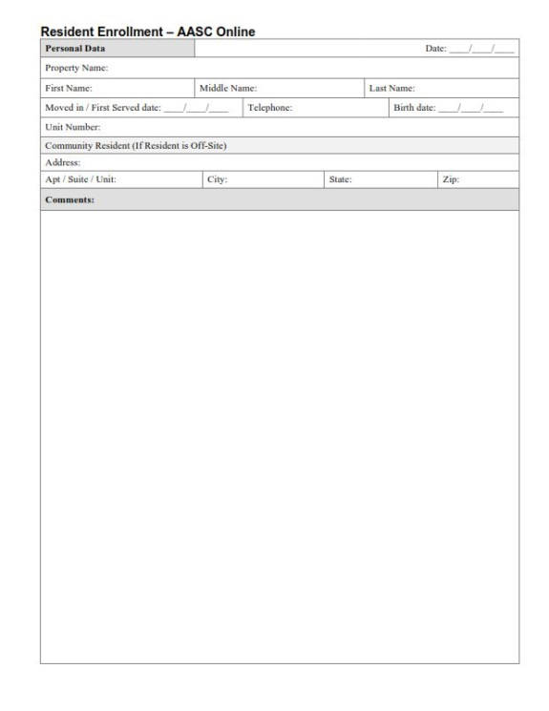
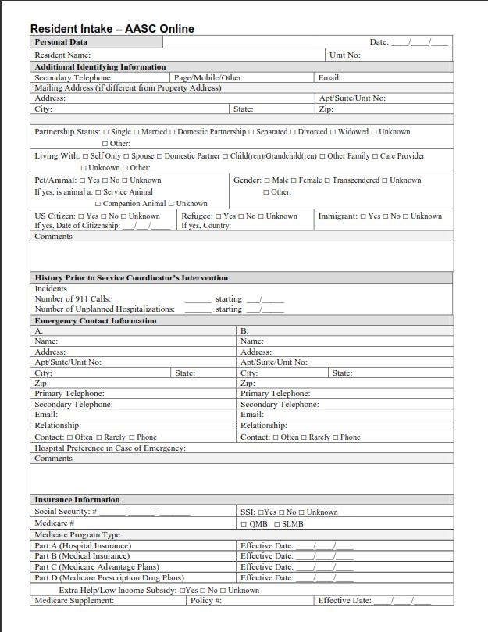
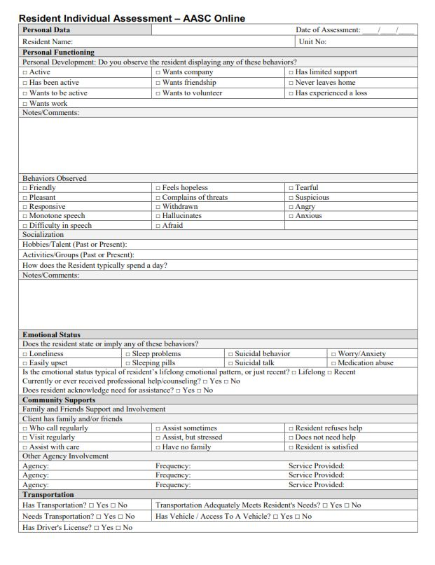
Case Management
www.pacifichousing.org

Slide 16
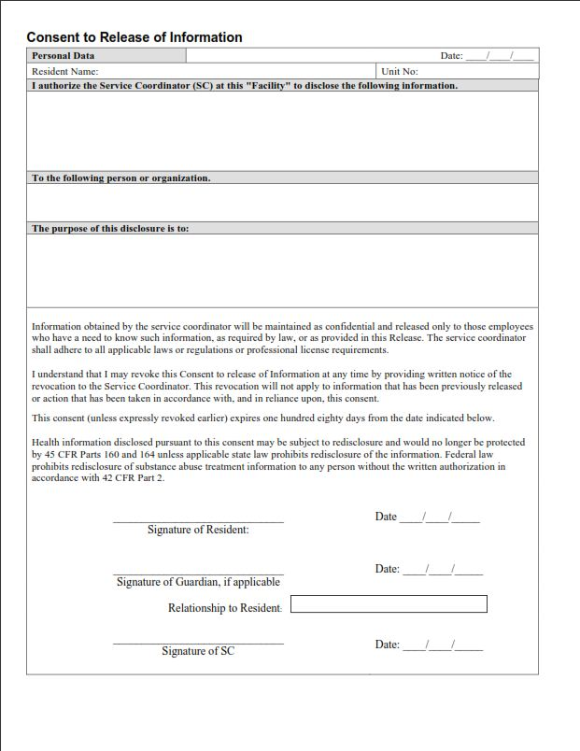
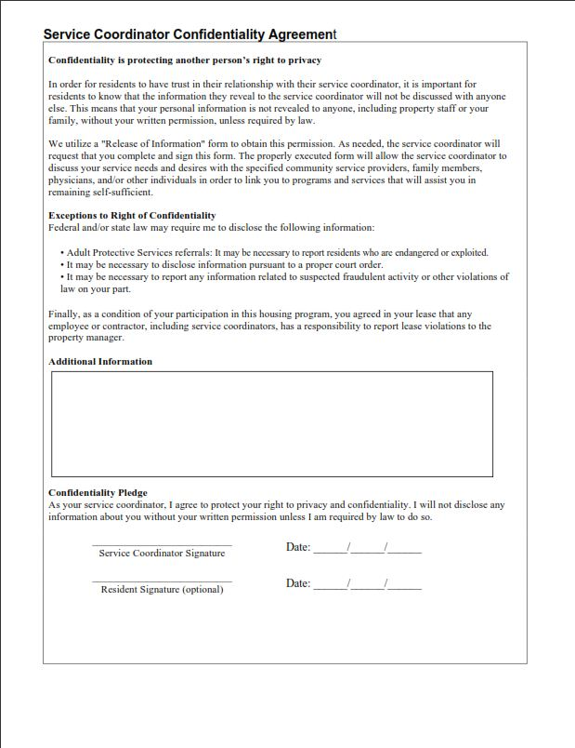
Case Management
www.pacifichousing.org

Slide 17

Self-Determination
The SC shall work in tandem with residents to empower them to utilize their own abilities and provide them with choices to make decisions regarding the services they receive. The SC shall ensure that residents are involved in the linkage and/or coordination of their services and will respect and promote their right of self-determination. SCs will assist residents in their efforts to identify and clarify their goals and shall not impose their opinions or preferences on a resident.
In issues involving a resident’s right to freedom of choice over personal safety, the resident has a right to choose to live at risk of harm or leave needs unmet, providing he/she is capable of making that choice, harms no one, and commits no crime. All residents have a right to choose their own life-style, as long as there are no lease violations and they are fulfilling their obligations of tenancy. In instances where the SC’s or resident’s safety and/or well being is threatened, the SC may need to take action to make linkages to services that may limit the resident’s right to self determination. It must be noted that the resident has the right to refuse the services of the service coordinator or the service coordination program if they so choose.
www.pacifichousing.org

Slide 18
Communication with Management/Owner
The SC is obligated to communicate information to management staff regarding the following:
the service coordinator job description/job duties;
the service coordinator role at the property;
SC obligations as a mandated reporter;
requirements of the HUD service coordinator program
and other important information related to the role of the SC.
The service coordinator should strive to assure lines of communication with management are timely and appropriate related to pertinent resident issues, educational programming and other service issues related to management/ building policy.
The Service Coordinator should avoid any personal interest or activity that conflicts or interferes with the welfare or best interest of his/her residents/ clients.
AASC – SC Professional Code of Ethics
www.pacifichousing.org

Slide 19
Privacy and Confidentiality
The SC shall ensure the resident’s right to privacy and ensure appropriate confidentiality when information is released to others. All information obtained by a SC about a resident is to be held in the strictest possible confidence. Additionally, the SC shall not discuss confidential matters in public or semipublic areas.
Informed Consent
Service coordinators shall assist and link residents to services only in the context of a professional relationship based, when appropriate, on valid informed consent (release of information). The SC may disclose confidential information only when legally necessary to prevent serious, foreseeable and imminent harm to themselves or someone else (this can include medical emergencies, domestic violence, mental health crisis, etc.)
AASC – SC Professional Code of Ethics
www.pacifichousing.org

Slide 20
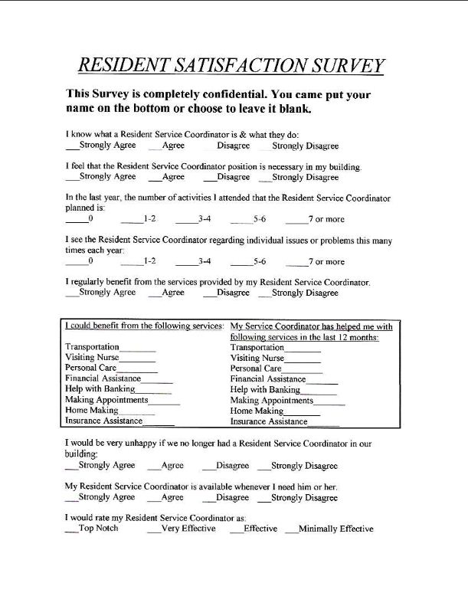
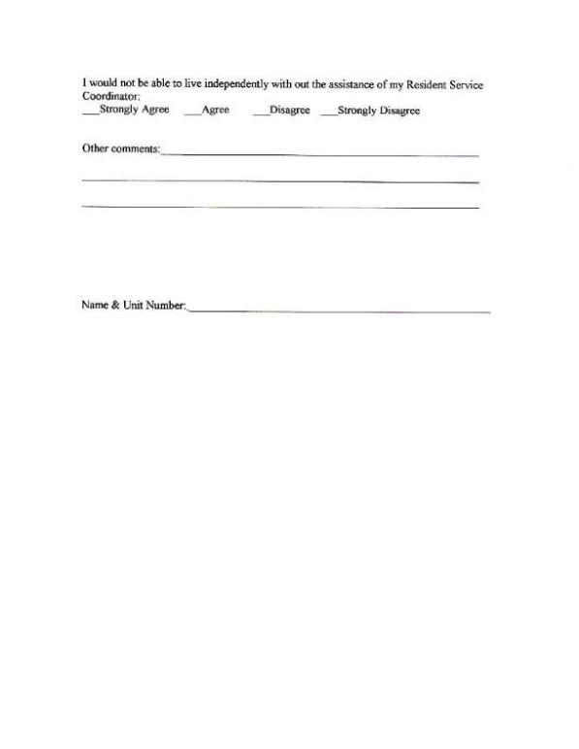
Resident Satisfaction Survey
www.pacifichousing.org

Slide 21

Questions & Answers

Slide 22
END OF PRESENTATION – THANK YOU.
Mario A. Lopez
Resident Service Coordinator
mlopez@pacifichousing.org
619.794.2953
www.pacifichousing.org

